Slide 1
DevOps and CI/CD
Application Modernization Series
Chatchai Kongmanee
Specialist Solution Architect
Red Hat, Thailand

Slide 2
Application Modernization Series
Roadmap
Introduction to Container
DevOps and CI/CD
What & Why Container?
Docker
Demo: Build App & DB with Docker
DevOps and CI/CD Concept
Everything as-a-Code
Demo: Build and Deploy with CI/CD Tool
Session 4
25 Mar 2021 15:00
(45 mins - 1 hour)
Session 2
11 Mar 2021 15:00
(45 mins - 1 hour)
Session 1
4 Mar 2021 15:00
(45 mins - 1 hour)
Session 3
18 Mar 2021 15:00
(45 mins - 1 hour)
Application Modernization
Introduction to Container Orchestration Platform
How to containerize existing App?
Demo: Application Migration Tool, New Framework for Container
What & Why Container Orchestration Platform?
Basic concept of Application Deployment on Container Orchestration Platform with Demo

Slide 3
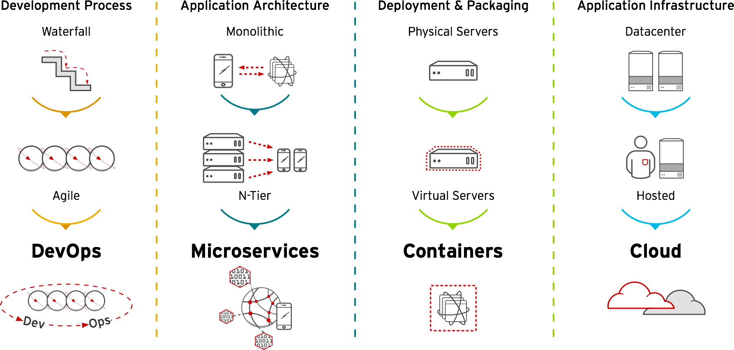

Evolution of Development Methodologies
Competition drives the need, the need for speed (and stability)
WATERFALL
AGILE
DEVOPS
Linear approach
Silo’d teams
Scope locked in (requirements defined before coding)
Architecture well documented
Delivery time: Weeks to Months
Iterative approach
Cross-functional teams
Prioritise backlog of user stories (requirements)
Architecture incremental
Delivery Time: Days to Week
Collaboration between business units
Focus on automating processes (pipeline)
Architecture is defined - need to consider how it will run/scale in prod
Delivery time: Hours to Days
Notes:
It is important to note how we got to DevOps, in terms of application delivery methodologies.
First we had waterfall (highlight two or three of the bullet points), which worked well except that a delivery time of ‘weeks to months’ in not acceptable in today’s hyper-competitive world.
This brought about agile (again read out two or three of the bullet points). While delivering software sprints of days to weeks was a big improvement is is not fast enough to keep up with the ‘elite’ performers
So that is how DevOps was born - extending to focus on collaboration/cultural changes between teams as well as a focus of automating delivery process

Slide 4

So what is this DevOps thingy then?
What is NOT DevOps
DevOps is NOT: a single product (nor a bunch of tools)
DevOps is NOT: a job role
DevOps is NOT: a process or set of processes
DevOps is NOT: just Agile 2.0
Notes:
There is no standard definition of DevOps - if you speak to 10 customers you will get 10 different ideas of what DevOps means. So I like to start with what is *NOT* DevOps
It is not a single product/SKU/solution. No one vendor can provide all of the capabilities to delivery ‘devops in a box’
Is is not a Job Role - like the definition, DevOps teams do many different things
It is not just a process or delivery methodology
And it is not just the next version of Agile

Slide 5
So what is this DevOps thingy then?
What IS DevOps
DevOps IS: a set of principles for software delivery
DevOps IS: a cultural change - collaboration of cross-functional
teams (not just Dev and Ops - Security, Test, Business too!)
DevOps IS: the focus of IT teams delivering value to the business.
Faster
Notes:
So what is DevOps then?
A set of principles that focus on fast, high quality and secure software delivery
The big one is the cultural change. All of the teams - not just Dev and Ops; but security, testing, the business owners, networking, compliance etc - need to work together to break down silos and achieve a common set of goals.
If I had to give a definition, DevOps is “the focus of IT teams delivering value to the business. Faster”. Note that I said “delivering value”, not “deliver code”, not “deliver hardware” or any other back end stuff. The end user does not care if it is running on cloud or a VM machine or what operating system the server is using. They care about the quality of service delivered, the user experience, the outcome it delivers.

Slide 6





DEVOPS
DEVELOPERS
I.T. OPERATIONS
Everything as code
Application monitoring
Automate everything
Rapid feedback
Continuous Integration/Delivery
Rebuild vs. Repair
Application is always “releaseable”
Delivery pipeline
Notes:
Many of the practices and values in DevOps aim at mitigating this problem. However despite the fact that DevOps was first introduced in 2009, it only gained popularity in the last two years. The reason for that was that implementing many of these practises proved to be extremely difficult using virtualization and other technologies which were available at the time.

Slide 7




DevOps Measurement
Deployment Frequency
How often does your organization deploy code?
Change Fail Rate
What percentage of changes results either in degraded service or subsequently requires remediation?
Change Fail Rate
What percentage of changes results either in degraded service or subsequently requires remediation?
Lead Time for Changes
How long does it take to go from code commit to code successfully running in production?
Time to Restore Service
How long does it generally take to restore service when a service incident occurs?
Notes:
(note the animations - each group has a separate animation)
We start by looking at the development side - which measure the velocity or throughput. The first KPI is Deployment Frequency - how often does your organization deploy code into production. Remember the survey grouped the respondents into different categories - from low to medium to high and then elite.
(read out the category and the metric for each click)
As we can see the elite outperform the low by a significant margin. One of the main reasons for this is automation - automating the build and configuration of environments (dev, test, UAT, staging etc) - infrastructure as code. This also extends to automated testing and reporting.
Mention some key capabilities:
Self-service infra (infra-as-code, auto provisioning, immutable, consistent environments)
Everything-as-code (config, infra, workflows; version controlled)
Automated unit, functional, integration, performance tests
Automated reporting
Automated approvals/promotion
Smaller releases (deployment volume)

Slide 8
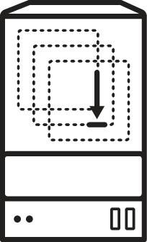
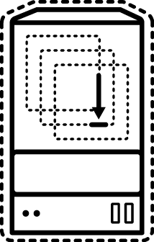


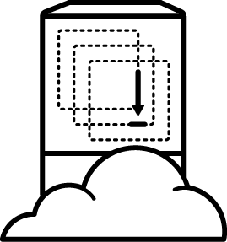
DevOps using Containers
Containers Provide Consistency
physical
virtual
private cloud
DevOps
containers
public cloud
Notes:
Taking advantage of this simplicity, dev teams in each iteration can build a docker image of the application once and ship that image to get deployed in various environments. The docker image can be deployed on target environments the exact same way regardless of if it’s physical, virtual, private or public cloud infrastructure.
The container packaging decouples the application from infrastructure and enables portability across the delivery cycle and infrastructure.

Slide 9



DevOps using Containers
Containers Provide Consistency
physical
virtual
private cloud
developers
source code repository
CI/CD engine
containers
public cloud
Notes:
How does a deployment pipeline look like with containers? It all begins with a developer committing a change to the source repository. The CI/CD engine (e.g. Jenkins) gets notified, downloads the application code from source repository and rebuilds the application with the new change. Introducing containers, the CI/CD engine at this stage will package the application as a container image which can be deployed on the target environment and runs the exact same way regardless of if it’s physical, virtual, private or public cloud infrastructure.

Slide 10
WHAT IS CI/CD?
Continuous Integration & Continuous Delivery
Build
Test
Security Checks
Release
Deploy Stage
Deploy Prod
Continuous Integration
Continuous Delivery
Notes:
Continuous integration (CI) and continuous delivery (CD) embody a culture, set of operating principles, and collection of practices that enable application development teams to deliver code changes more frequently and reliably. This is often achieved through automating the steps required for delivering software via creating a number of delivery pipelines that represent entire or phases of delivering a piece of software throughout the delivery process. The end goal of CI/CD is faster software delivery and increased quality due to repeatable, predictable and consistent nature of the delivery process.
Although not all applications are deployed on Kubernetes in production, containers and Kubernetes have provided the flexibility that organisations need in order to automate their delivery process. As a consequence, Kubernetes is widely used during the local development and CI/CD phases even for apps that eventually get deployed onto VMs or other platforms.

Slide 11



BUILD AND DEPLOY CONTAINER IMAGES
DEPLOY YOUR
SOURCE CODE
DEPLOY YOUR
APP BINARY
DEPLOY YOUR
CONTAINER IMAGE

Slide 12




DEPLOY SOURCE CODE WITH SOURCE-TO-IMAGE (S2I)
BUILD APP
(OpenShift)
code
Git Repository
Developer
BUILD IMAGE
(OpenShift)
Source-to-Image (S2I)
Builder Image
Image Registry
DEPLOY
(OpenShift)
Application Container
deploy
User/Tool Does
OpenShift Does
Notes:
Blue: OpenShift does Green: User does
Developers write code using existing development tools such as Maven, NPM, Bower, PIP, Dockerfile and Git and then access the OpenShift Web, CLI or IDE to create an app from the code
S2I combines source code with a builder image (language and application runtimes) and stores the resulting application image in the image registry
This image registry by default is the OpenShift integrated docker registry however users can configure S2I to push the built images to third-party registries such as Docker Hub, Nexus, Artifactory, Amazon ECR, Quay, etc.
OpenShift monitors the builder images in the image registry and can automatically rebuild the application images if the language (e.g. Java, Ruby, etc) or application runtime (JBoss EAP, JBoss Web Server, Tomcat, etc) image is updated for example due to security patches.
OpenShift automates the deployment of application containers across multiple hosts via the Kubernetes. Users can trigger deployments, rollback, configure A/B or other custom deployments

Slide 13

DEPLOY APP BINARY WITH SOURCE-TO-IMAGE (S2I)
build
BUILD APP
(Build Infra)
Application Binary (e.g. WAR)
Existing Build Process
BUILD IMAGE
(OpenShift)
Source-to-Image (S2I)
Builder Image
Image Registry
DEPLOY
(OpenShift)
Application Container
deploy
User/Tool Does
OpenShift Does
Notes:
Blue: OpenShift does Green: User does
Developers use the existing build process and tools (e.g. Maven, Gradle, Jenkins, Nexus) to build the app binaries (e.g. JAR, WAR, EAR) and use OpenShift CLI to create an app from the app binaries
S2I combines app binaries (e.g. JAR, WAR, EAR) with a builder image (language and application runtimes) and stores the resulting application image in the image registry
This image registry by default is the OpenShift integrated docker registry however users can configure S2I to push the built images to third-party registries such as Docker Hub, Nexus, Artifactory, Amazon ECR, Quay, etc.
OpenShift monitors the builder images in the image registry and can automatically rebuild the application images if the language (e.g. Java, Ruby, etc) or application runtime (JBoss EAP, JBoss Web Server, Tomcat, etc) image is updated for example due to security patches.
OpenShift automates the deployment of application containers across multiple hosts via the Kubernetes. Users can trigger deployments, rollback, configure A/B or other custom deployments

Slide 14

DEPLOY DOCKER IMAGE
BUILD IMAGE
(Build Infra)
build
Application Image
Existing Image
Build Process
PUSH
(Build Infra)
Image Registry
DEPLOY
(Openshift)
deploy
Application Container
User/Tool Does
OpenShift Does
Notes:
Blue: OpenShift does Green: User does
App images are built using an existing image build process. OpenShift automates the deployment of app containers across multiple hosts via the Kubernetes. Users can trigger deployments, rollback, configure A/B, etc

Slide 15



BUILD IMAGES IN MULTIPLE STAGES
BUILD STAGE 1
BUILD STAGE 3
BUILD STAGE 2
Notes:
For compiled languages (Go, C, C++, Java, etc.), including the dependencies necessary for compilation in the application image might increase the size of the image or introduce vulnerabilities that can be exploited. To avoid these problems, two builds can be chained together: one that produces the compiled artifact, and a second build that places that artifact in a separate image that runs the artifact.
The first builds (stage 1 and stage 2) can use any of the build strategies on OpenShift such as Source-to-Image, Docker build, etc that will produce an image containing the desired artifacts
The second build (stage 3) can use any strategy that can consume input content from an image such as Docker build.

Slide 16

EXAMPLE: USE ANY BUILD TOOL WITH OFFICIAL RUNTIME IMAGES
Use your choice of build tool like Gradle and deploy to official images like the JDK image
CUSTOM GRADLE BUILD
app.war
DOCKER BUILD
Custom
Gradle S2I
Builder Image
Red Hat
OpenJDK
Image
read more on https://blog.openshift.com/chaining-builds/
Notes:
Another example is when you want to use one of the officially supported image runtimes provided by OpenShift e.g. Java image, but you would like to use an alternative build tool rather than the one available in the image e.g. Gradle instead of Maven

Slide 17
EXAMPLE: SMALL LEAN RUNTIMES
Build the app binary and deploy on small scratch images
CUSTOM GO BUILD
app
DOCKER BUILD
Custom
Go S2I
Builder Image
Scratch Image
read more on https://blog.openshift.com/chaining-builds/
Notes:
Another example is when you want to use minimal scratch images to run your app in order to have a minimal attack surface and footprint. You can use a customer builder image like Go S2I build image and then copy the app binary to the scratch image using a Dockerfile

Slide 18
CI/CD WITH BUILD AND DEPLOYMENTS
BUILDS
Webhook triggers: build the app image whenever the code changes
Image trigger: build the app image whenever the base language or app runtime changes
Build hooks: test the app image before pushing it to an image registry
DEPLOYMENTS
Deployment triggers: redeploy app containers whenever configuration changes or the image changes in the OpenShift integrated registry or upstream registries

Slide 19
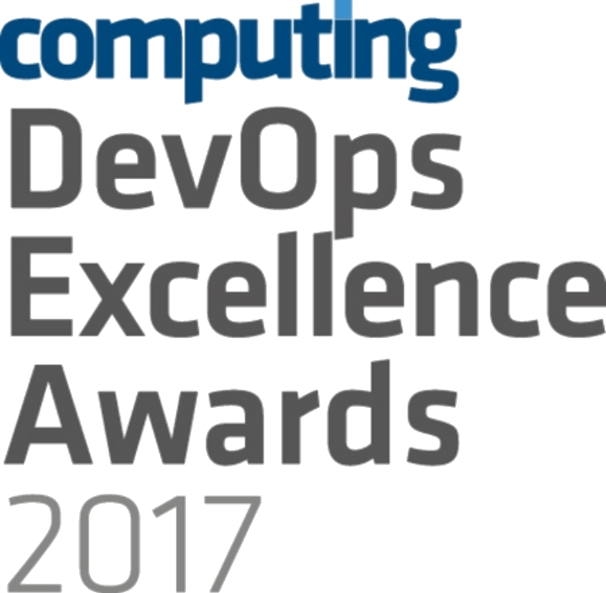



OPENSHIFT LOVES CI/CD
JENKINS-AS-A SERVICE
ON OPENSHIFT
HYBRID JENKINS INFRA WITH OPENSHIFT
EXISTING CI/CD DEPLOY TO OPENSHIFT
Notes:
OpenShift loves CI/CD and is in fact the winner of DevOps Excellence Awards 2017 in the Best Development Platform category http://events.computing.co.uk/devopsexcellence/static/2017-winners
OpenShift provides certified Jenkins container images as well as a number of Jenkins plugins to facilitate integrating Jenkins with OpenShift and building CI/CD Pipelines. Teams can decide how they want to use OpenShift for building CI/CD workflows considering their previous investments into their existing CI/CD infrastructure:
Jenkins-as-a-Service on OpenShift: run your Jenkins masters and slaves in OpenShift, by providing "Jenkins as a Service" on the platform.
Hybrid: Keep your Jenkins master infrastructure as it is, run Jenkins agents in OpenShift containers for extra build capacity when you need it.
Keep Everything As-Is: Run your CI/CD infrastructure outside of OpenShift as-is and just use OpenShift as a deployment platform. Has the advantage of not disturbing what the customer already has in place and also allowing them to continue using alternate, non-Jenkins based CI and CD like Bamboo, TeamCity, Go CD, etc.

Slide 20
JENKINS-AS-A-SERVICE ON OPENSHIFT
Certified Jenkins images with pre-configured plugins
Provided out-of-the-box
Follows Jenkins 1.x and 2.x LTS versions
Jenkins S2I Builder for customizing the image
Install Plugins
Configure Jenkins
Configure Build Jobs
OpenShift plugins to integrate authentication with OpenShift and also CI/CD pipelines
Dynamically deploys Jenkins agent containers
Plugins Jobs
Configuration
Jenkins (S2I)
Jenkins Image
Custom Jenkins Image

Slide 21
HYBRID JENKINS INFRA WITH OPENSHIFT
Scale existing Jenkins infrastructure by dynamically provisioning Jenkins agents on OpenShift
Use Kubernetes plug-in on existing Jenkin servers
JENKINS
MASTER
OPENSHIFT
JENKINS AGENT
JENKINS AGENT
build
APP
APP
run job
deploy
Run Job
Run Job
Notes:
Using Kubernetes Jenkins Plugin on the existing Jenkins infrastructure, Jenkins can dynamically provisioning Jenkins agent containers on OpenShift and have them automatically discovered by the Jenkins master. Jenkins master then delegates running the build job to the Jenkins agent
container and tears it down after build job is complete. The build job can use OpenShift Pipeline Jenkins Plugin to perform operations on OpenShift such as
Trigger a build
Trigger a deployment
Create and remove resources
Scale up and down
Any many more
Dynamic provisioning of Jenkins agent containers allows running many build jobs in parallel and scale running Jenkins jobs only when required. This removes the need for having dedicated Jenkins agent nodes waiting for a build job to be submitted which causes a lot of idle time and results in wasted resources with low utilization.

Slide 22
EXISTING CI/CD DEPLOY TO OPENSHIFT
Existing CI/CD infrastructure outside OpenShift performs operations against OpenShift
OpenShift Pipeline Jenkins Plugin for Jenkins
OpenShift CLI for integrating other CI Engines with OpenShift
Without disrupting existing processes, can be combined with previous alternative
EXISTING
CI/CD INFRA Jenkins, Bamboo, TeamCity, etc
OPENSHIFT
S2I
Build
APP
APP
run job
build
deploy
Notes:
OpenShift Pipeline Jenkins Plugin extends the Jenkins Pipeline DSL format with additional blocks to perform operations on OpenShift such as
Trigger a build
Trigger a deployment
Create and remove resources
Scale up and down
Any many more

Slide 23
OPENSHIFT PIPELINES
OpenShift Pipelines allow defining a CI/CD workflow via a Jenkins pipeline which can be started, monitored, and managed similar to other builds
Dynamic provisioning of Jenkins agents
Auto-provisioning of Jenkins server
OpenShift Pipeline strategies
Embedded Jenkinsfile
Jenkinsfile from a Git repository
apiVersion: v1 kind: BuildConfig metadata: name: app-pipeline spec: strategy: type: JenkinsPipeline jenkinsPipelineStrategy: jenkinsfile: |- node('maven') { stage('build app') { git url: 'https://git/app.git' sh "mvn package" } stage('build image') {
sh "oc start-build app --from-file=target/app.jar
}
stage('deploy') {
openshiftDeploy deploymentConfig: 'app'
}
}
Provision a Jenkins agent for running Maven
Notes:
Jenkinsfile is a text file that contains the Jenkins Pipeline definition using the Jenkins Pipeline DSL. Jenkinsfile is the recommended approach for creating Jenkins Pipelines rather than defining it via the Jenkins UI
OpenShift Pipeline build strategy supports two methods for defining a Jenkinsfile:
Embedding a Jenkinsfile within the BuildConfig
Pulling the Jenkinsfile from a Git Repository. This approach has the advantage of version controlling the pipeline definition (Jenkinsfile) as well as allowing developers to update the pipeline by modifying the Jenkinsfile in the Git repository. Next time the pipeline starts executing, it would pull the updated Jenkinsfile and run the updated pipeline.

Slide 24
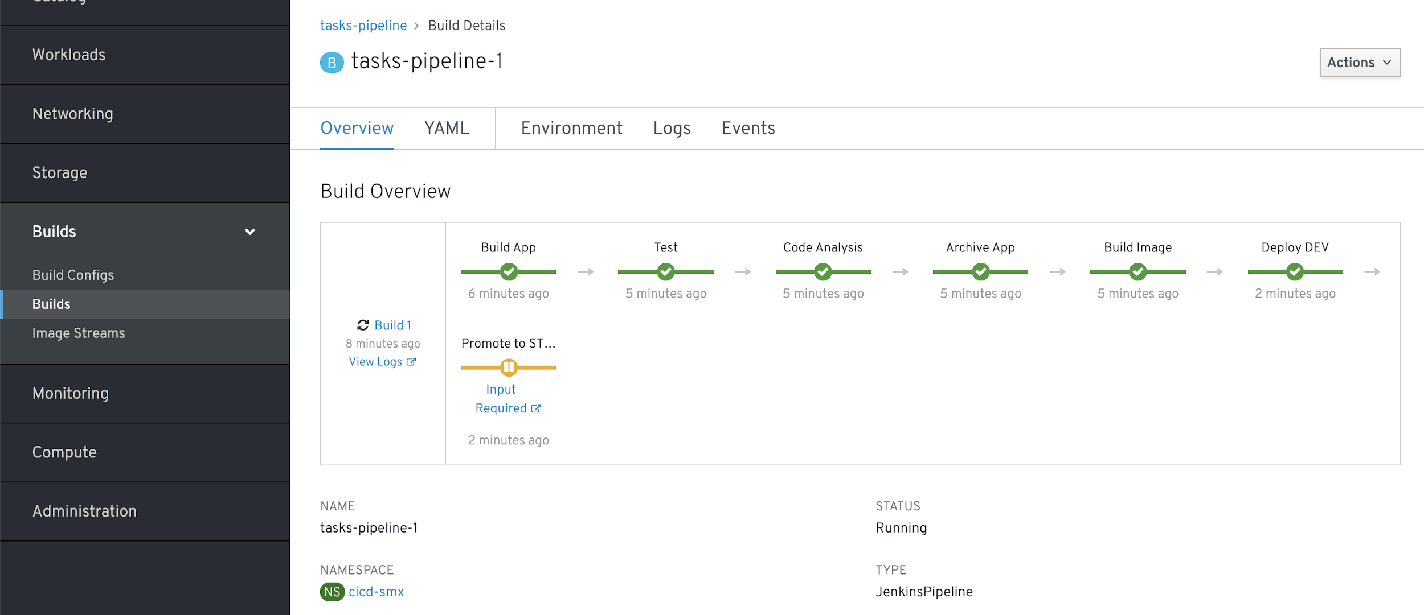
OpenShift Pipelines in
Web Console

Slide 25


CONTINUOUS DELIVERY PIPELINE
DEVELOPER
GIT SERVER
ARTIFACT REPOSITORY
OPENSHIFT
CI/CD PIPELINE
(JENKINS)
IMAGE BUILD
& DEPLOY
OPENSHIFT
IMAGE
REGISTRY
OPENSHIFT
IMAGE
REGISTRY
OPENSHIFT
CLUSTER
OPENSHIFT
CLUSTER
NON-PROD
DEV
PROD

Slide 26
CONTINUOUS DELIVERY PIPELINE
DEVELOPER
GIT SERVER
ARTIFACT REPOSITORY
OPENSHIFT
CI/CD PIPELINE
(JENKINS)
IMAGE BUILD
& DEPLOY
PROMOTE
TO TEST
OPENSHIFT
IMAGE
REGISTRY
OPENSHIFT
IMAGE
REGISTRY
OPENSHIFT
CLUSTER
OPENSHIFT
CLUSTER
NON-PROD
DEV
TEST
PROD

Slide 27
CONTINUOUS DELIVERY PIPELINE
DEVELOPER
GIT SERVER
ARTIFACT REPOSITORY
OPENSHIFT
CI/CD PIPELINE
(JENKINS)
IMAGE BUILD
& DEPLOY
PROMOTE
TO TEST
PROMOTE
TO UAT
OPENSHIFT
IMAGE
REGISTRY
OPENSHIFT
IMAGE
REGISTRY
OPENSHIFT
CLUSTER
OPENSHIFT
CLUSTER
NON-PROD
DEV
TEST
UAT
PROD

Slide 28
CONTINUOUS DELIVERY PIPELINE
DEVELOPER
GIT SERVER
ARTIFACT REPOSITORY
RELEASE MANAGER
ServiceNow
JIRA Service Desk Zendesk
BMC Remedy
GO LIVE?
OPENSHIFT
CI/CD PIPELINE
(JENKINS)
☒
☑
IMAGE BUILD
& DEPLOY
PROMOTE
TO TEST
PROMOTE
TO UAT
OPENSHIFT
IMAGE
REGISTRY
OPENSHIFT
IMAGE
REGISTRY
OPENSHIFT
CLUSTER
OPENSHIFT
CLUSTER
NON-PROD
DEV
TEST
UAT
PROD
Notes:
The deployment pipeline pauses for the approval of release manager, deployment manager, etc. This step is typically integrated into the existing IT workflow management system such as ServiceNow, JIRA Service Desk, etc so that eligible user groups receive notification when a deployment requires approval. They would in that case be able to log in into their IT workflow management dashboard and approve or reject the production deployment based on the provided deployment details.

Slide 29
CONTINUOUS DELIVERY PIPELINE
DEVELOPER
GIT SERVER
ARTIFACT REPOSITORY
RELEASE MANAGER
GO LIVE?
OPENSHIFT
CI/CD PIPELINE
(JENKINS)
☒ ☑
IMAGE BUILD
& DEPLOY
PROMOTE
TO TEST
PROMOTE
TO UAT
PROMOTE
TO PROD
OPENSHIFT
IMAGE
REGISTRY
OPENSHIFT
IMAGE
REGISTRY
OPENSHIFT
CLUSTER
OPENSHIFT
CLUSTER
NON-PROD
DEV
TEST
UAT
PROD

Slide 30
DEVELOPER WORKFLOW

Slide 31
LOCAL DEVELOPMENT WORKFLOW
Bootstrap
Develop
Local
Deploy
Verify
Git Push
Pipeline
Notes:
Local development workflow describes the process of writing code and testing it locally on a development workstation. Although the local development workflow varies a lot from between teams and organizations, the current slide presents a common workflows used with OpenShift.

Slide 32
LOCAL DEVELOPMENT WORKFLOW
Bootstrap
Develop
Local
Deploy
Verify
Git Push
Pipeline
BOOTSTRAP
Pick your programming language and application runtime of choice
Create the project skeleton from scratch or use a generator such as
Maven archetypes
Quickstarts and Templates
OpenShift Generator
Spring Initializr

Slide 33
LOCAL DEVELOPMENT WORKFLOW
Bootstrap
Develop
Local
Deploy
Verify
Git Push
Pipeline
DEVELOP
Pick your framework of choice such as Java EE, Spring, Ruby on Rails, Django, Express, ...
Develop your application code using your editor or IDE of choice
Build and test your application code locally using your build tools
Create or generate OpenShift templates or Kubernetes objects

Slide 34
LOCAL DEVELOPMENT WORKFLOW
Bootstrap
Develop
Local
Deploy
Verify
Git Push
Pipeline
LOCAL DEPLOY
Deploy your code on a local OpenShift cluster
Red Hat Container Development Kit (CDK), minishift and oc cluster
Red Hat CDK provides a standard RHEL-based development environment
Use binary deploy, maven or CLI rsync to push code or app binary directly into containers
Notes:
CDK, minishift and oc cluster are all available on MacOS, Windows and Linux
Binary deploy and rsync allow pushing code and application binary into the container without the need to push the code to the Git repository in order to test the application

Slide 35
LOCAL DEVELOPMENT WORKFLOW
Bootstrap
Develop
Local
Deploy
Verify
Git Push
Pipeline
VERIFY
Verify your code is working as expected
Run any type of tests that are required with or without other components (database, etc)
Based on the test results, change code, deploy, verify and repeat

Slide 36
LOCAL DEVELOPMENT WORKFLOW
Bootstrap
Develop
Local
Deploy
Verify
Git Push
Pipeline
GIT PUSH
Push the code and configuration to the Git repository
If using Fork & Pull Request workflow, create a Pull Request
If using code review workflow, participate in code review discussions

Slide 37
LOCAL DEVELOPMENT WORKFLOW
Bootstrap
Develop
Local
Deploy
Verify
Git Push
Pipeline
PIPELINE
Pushing code to the Git repository triggers one or multiple deployment pipelines
Design your pipelines based on your development workflow e.g. test the pull request
Failure in the pipeline? Go back to the code and start again

Slide 38

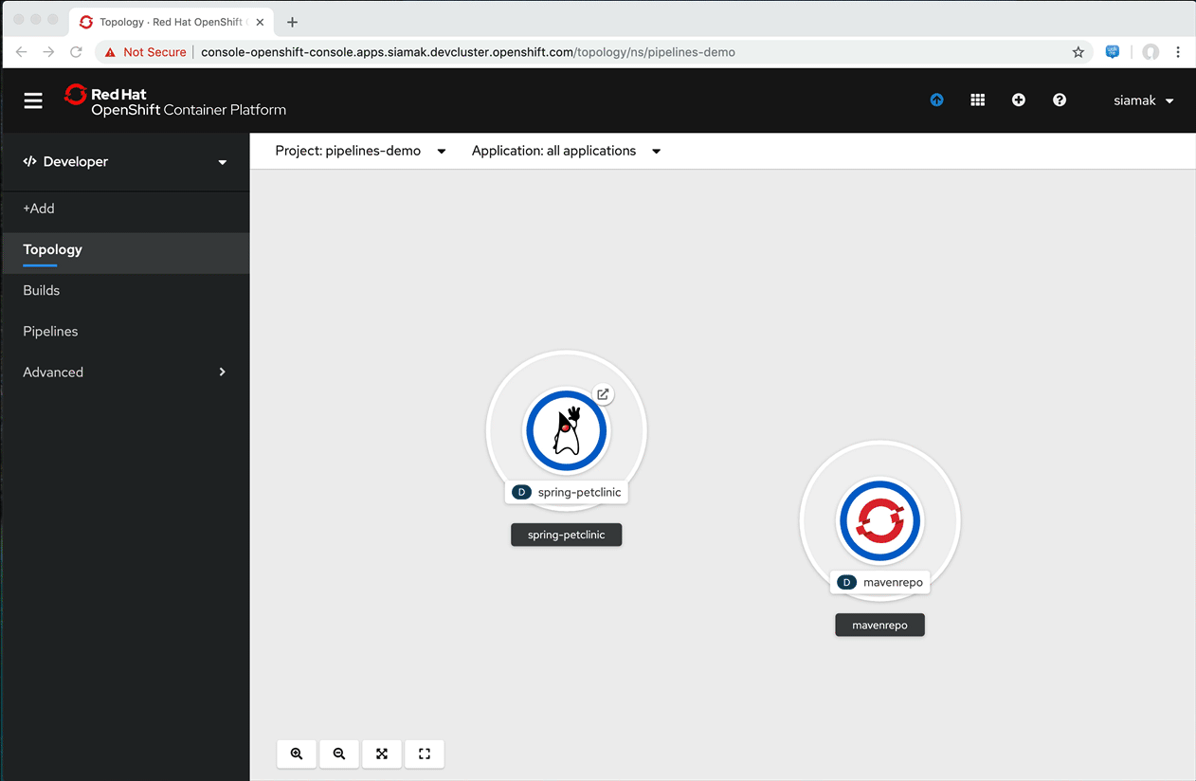
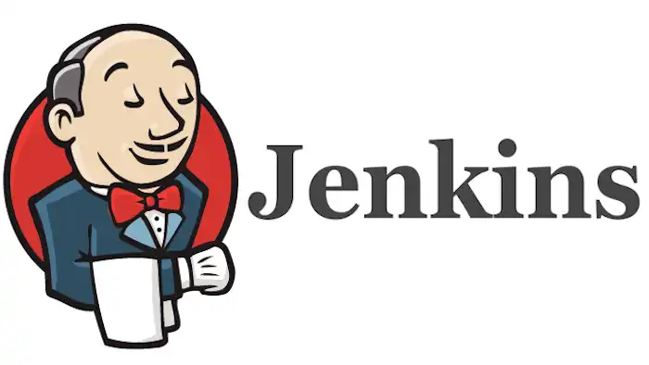
OpenShift Pipelines
OpenShift Pipelines
Authoring pipelines with Pipeline builder
Runs serverless (no CI engine!)
Share data between tasks in pipeline
Workspaces for sharing artifacts
Results for small data e.g. commit sha
Webhooks
Default GitHub TriggerBinding
Filtering on payload (event, files, etc)
Add to payload with CEL expressions
Custom processing with interceptors
Proxy support for git repositories
Support Jenkins (both internal and external OpenShift)

Slide 39
Let’s Demo

Slide 40
DEPLOY SOURCE CODE WITH SOURCE-TO-IMAGE (S2I)
BUILD APP
(OpenShift)
code
Git Repository
Developer
BUILD IMAGE
(OpenShift)
Source-to-Image (S2I)
Builder Image
Image Registry
DEPLOY
(OpenShift)
Application Container
deploy
User/Tool Does
OpenShift Does
Wait example ????
Notes:
Blue: OpenShift does Green: User does
Developers write code using existing development tools such as Maven, NPM, Bower, PIP, Dockerfile and Git and then access the OpenShift Web, CLI or IDE to create an app from the code
S2I combines source code with a builder image (language and application runtimes) and stores the resulting application image in the image registry
This image registry by default is the OpenShift integrated docker registry however users can configure S2I to push the built images to third-party registries such as Docker Hub, Nexus, Artifactory, Amazon ECR, Quay, etc.
OpenShift monitors the builder images in the image registry and can automatically rebuild the application images if the language (e.g. Java, Ruby, etc) or application runtime (JBoss EAP, JBoss Web Server, Tomcat, etc) image is updated for example due to security patches.
OpenShift automates the deployment of application containers across multiple hosts via the Kubernetes. Users can trigger deployments, rollback, configure A/B or other custom deployments

Slide 41

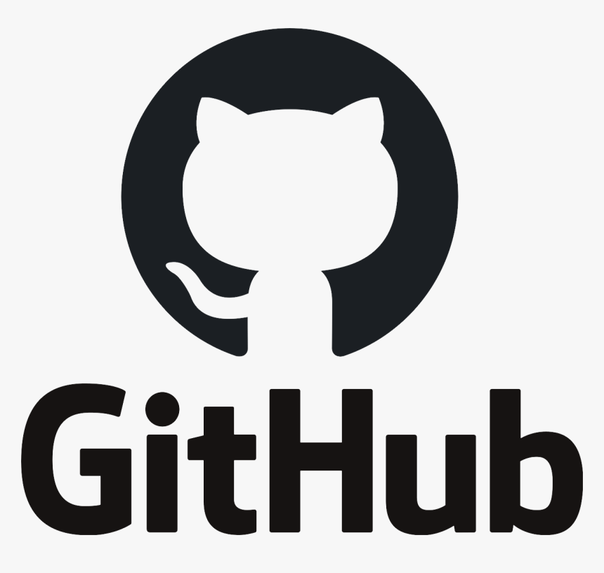
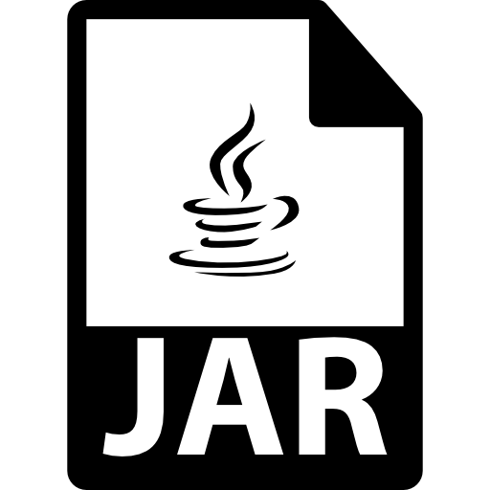



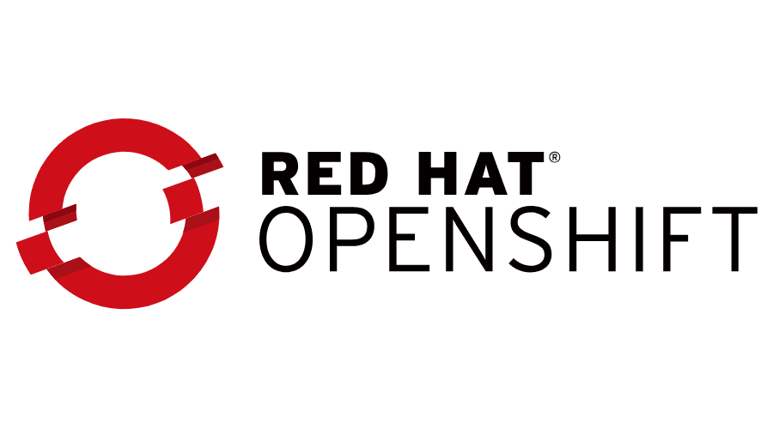
app: version
App
1.0.2
Router
https://github.com/chatapazar/demo-1.git
DEV

Slide 42
Thank you
Red Hat is the world’s leading provider of enterprise open source software solutions. Award-winning support, training, and consulting services make Red Hat a trusted adviser to the Fortune 500.

